Slide 1
BioPerl Creating a Pipeline
Ganna Androsova 07.01.201

Slide 2
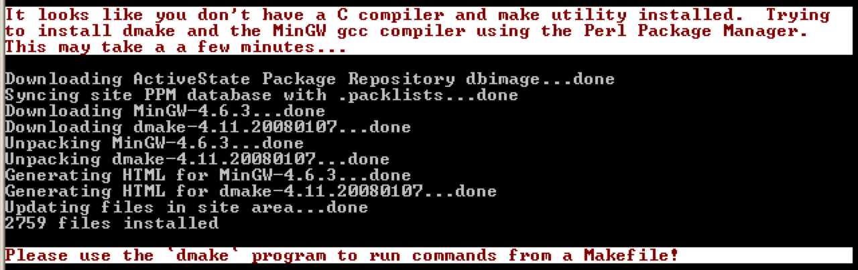
Install BioPerl
Open command line -> type: perl -MCPAN -e shell
(If CPAN is not installed it will automatically download all
the modules)
Type: install Bio::Perl
Type (if asked): y
When ‘cpan>’ appears, type: exit

Slide 3
Alternative Way to Install BioPerl
Go to http://search.cpan.org
Search for “Bio::Perl”
Choose the first result
Download: BioPerl-1.6.924.tar.gz (top right corner)
Open command line -> type: cd Desktop ->
tar -zxvf HTML-Template-2.8.tar.gz -> perl
Makefile.PL -> make -> make test -> make installs

Slide 4
Creating a Pipeline
Create a new file “GenBank.pl”
We obtained a query object, but not a sequence yet
#!/usr/bin/perl
use strict;
###### Retrieve multiple sequences from GenBank ######
use Bio::DB::GenBank;
use Bio::DB::Query::GenBank;
my $query = "Arabidopsis[ORGN] AND topoisomerase[TITL] and 0:3000[SLEN]";
my $query_obj = Bio::DB::Query::GenBank->new(-db => 'nucleotide', -query => $query );
# constructs a query object

Slide 5
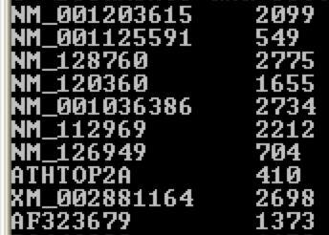
Creating a Pipeline
To retrieve the sequences we have to create a database object that can get Sequence objects for us
Results
Warning. Be careful what you ask for, many of today's nucleotide database entries are genome-size and you will probably run out of memory if your query happens to match one of these monstrosities. You can use the SLEN field to limit the size of the sequences you retrieve.
my $gb_obj = Bio::DB::GenBank->new; #creates a "database object”
my $stream_obj = $gb_obj->get_Stream_by_query($query_obj);
while (my $seq_obj = $stream_obj->next_seq) {
# print the sequence object
print $seq_obj -> display_id, "\t", $seq_obj -> length, "\n";
}

Slide 6
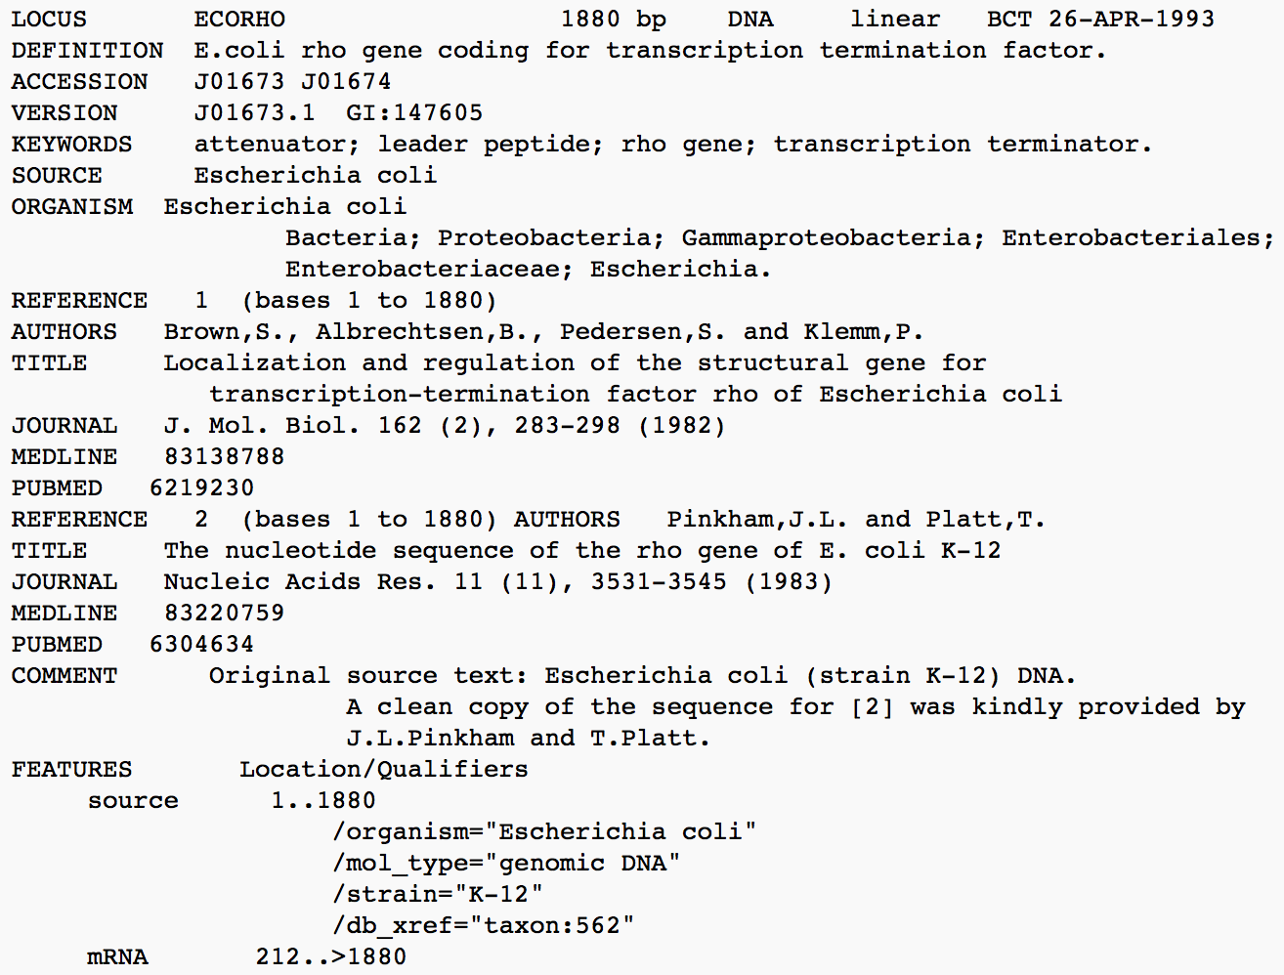
Genbank File Look

Slide 7
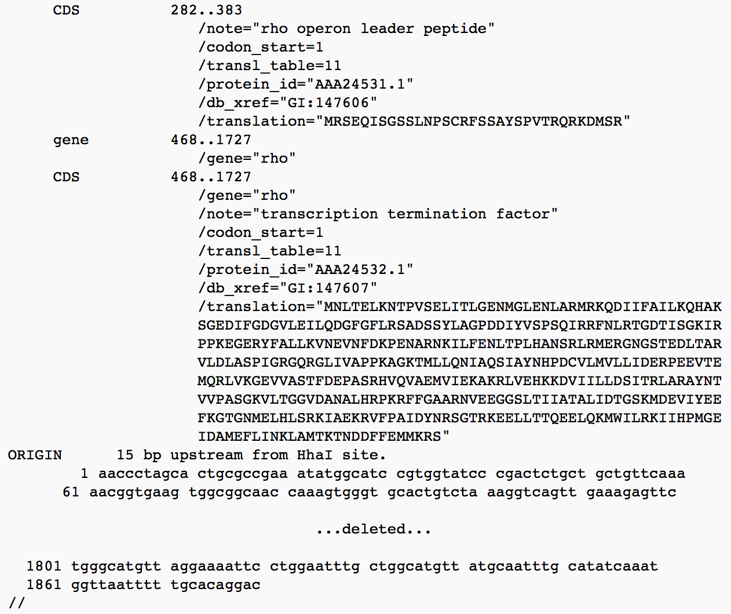
Genbank File Look

Slide 8
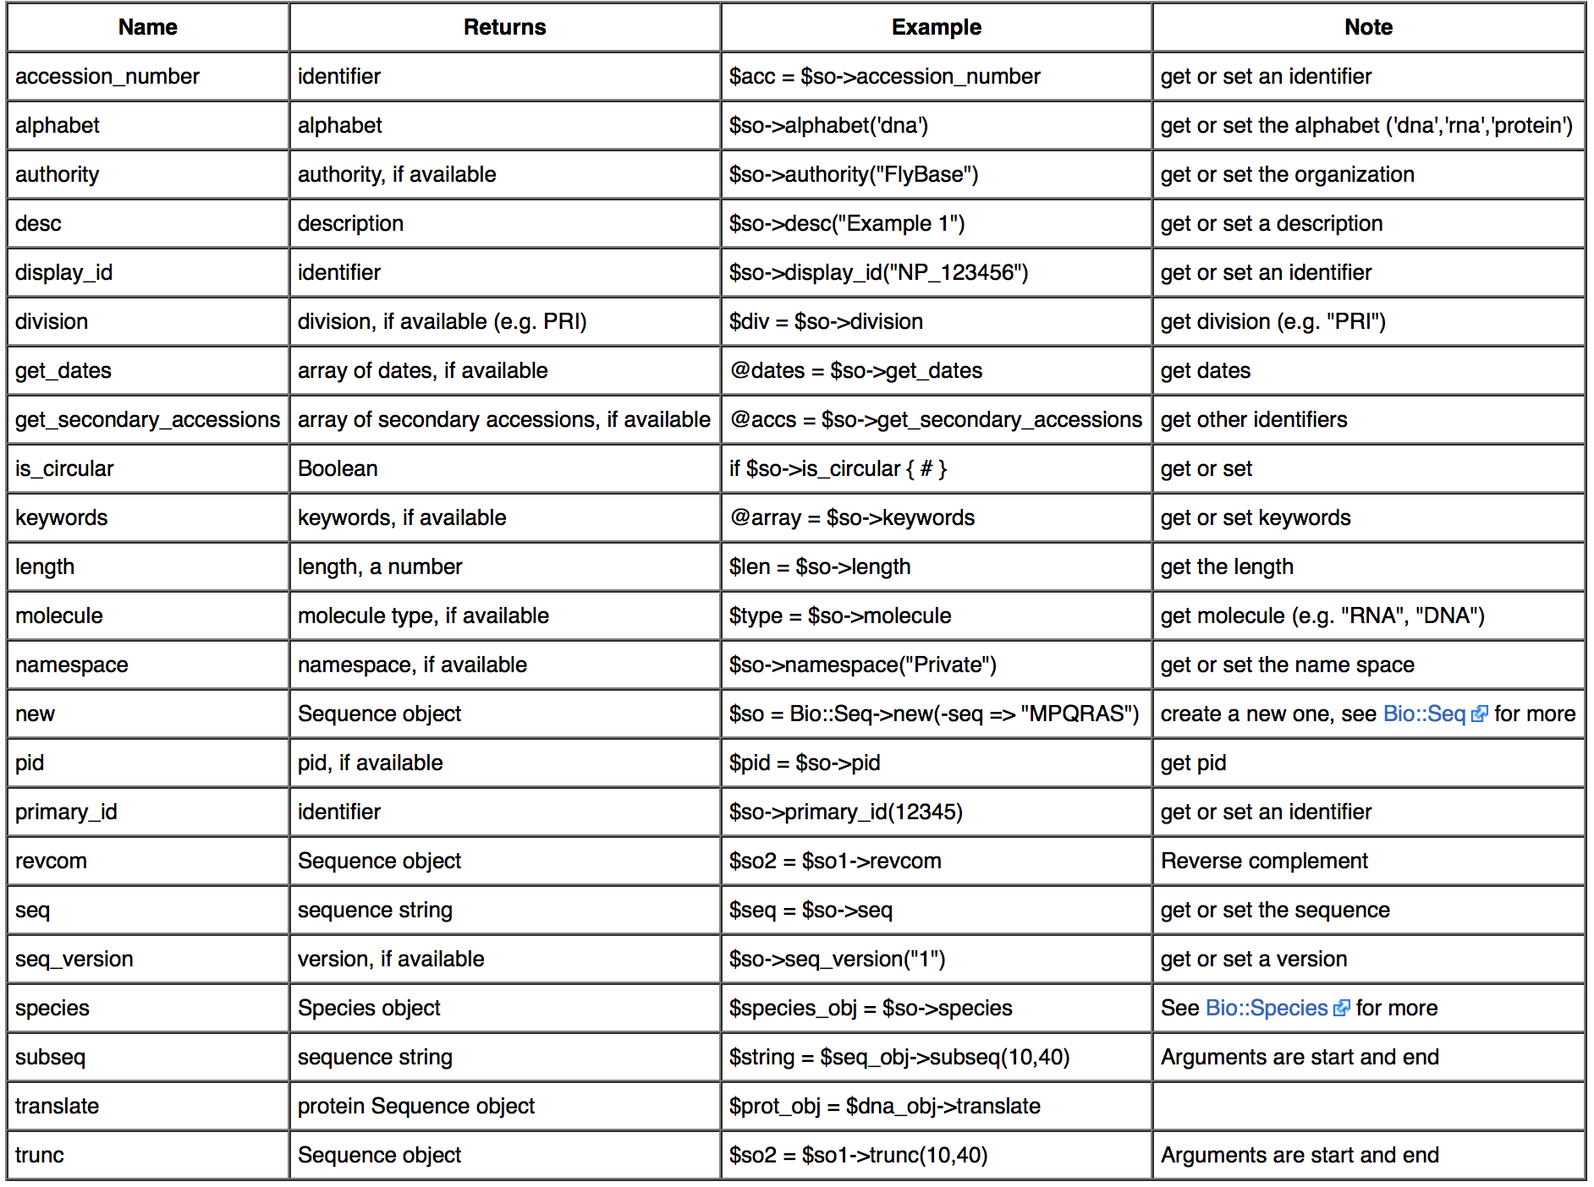
Sequence Object Methods

Slide 9
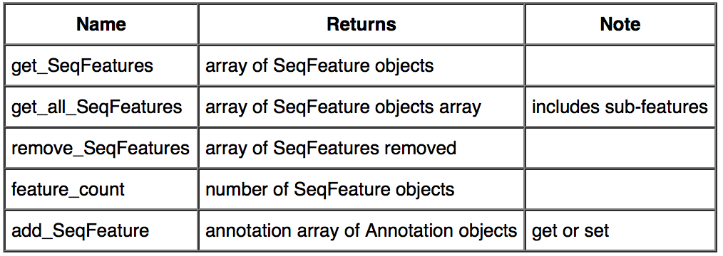
Feature and Annotation Methods

Slide 10
Creating a Pipeline
####### Let's analyse one of the sequences ######
#Get the sequence
my $seq_obj = $stream_obj->next_seq;
my $seq_string = $seq_obj->seq;
print $seq_string, "\n";
#Translate DNA/RNA sequence into protein
my $protein = ($seq_obj->translate)->seq;
print $protein, “\n”;
translate represents terminator by * and unknown amino acids by X
You can change this settings by:
$prot_obj = $my_seq_object->translate(-terminator => '-');
$prot_obj = $my_seq_object->translate(-unknown => '_');

Slide 11
Creating a Pipeline
Find N-glycosylation site motif (Asn, followed by anything but Pro, followed by either Ser or Thr, followed by anything but Pro)
N = Asn, P = Pro, S = Ser, T = Thr;
#Find motif in protein sequence
my $motif =
#Find motif in protein sequence
my $motif = “(N[ARNDCEQGHILKMFSTWYV][S|T][ARNDCEQGHILKMFSTWYV])”;
my $motif_seq = “”;
if ($protein =~ /($motif/){
$motif_seq = $1;
print "found motif: $motif_seq \n\n";
} else {
print "not found \n\n";
}

Slide 12
Creating a Pipeline
Find the position of N-glycosylation site motif
#Find motif in protein sequence
my $motif = “(N[ARNDCEQGHILKMFSTWYV][S|T][ARNDCEQGHILKMFSTWYV])”;
my $motif_seq = “”;
if ($protein =~ /($motif/){
$motif_seq = $1;
print "found motif: $motif_seq \n\n";
} else {
print "not found \n\n";
}
#Find motif in protein sequence
my $motif = “(N[ARNDCEQGHILKMFSTWYV][S|T][ARNDCEQGHILKMFSTWYV])”;
my $motif_seq = “”;
my @position = “”;
if ($protein =~ /($motif/){
$motif_seq = $1;
print "found motif: $motif_seq \n\n";
push (@position, $-[0]); #$-[0] is the offset of start of last successful match.
print “At position: ”, @position, “\n”;
} else {
print "not found \n\n";
}

Slide 13
Creating a Pipeline
Let’s write all results into file:
If you didn’t get any error -> go to folder “perl” and check file “results.txt”
open OUTPUT, ">results.txt";
print OUTPUT "Initial sequense: \n", $seq_string, "\n\n",
"Protein sequense: \n", $protein, "\n\n",
"N-glycosylation motif: ", $motif_seq, " at position ", @position;
close OUTPUT;

